Slide 1
Text Mining & NLP

Slide 2
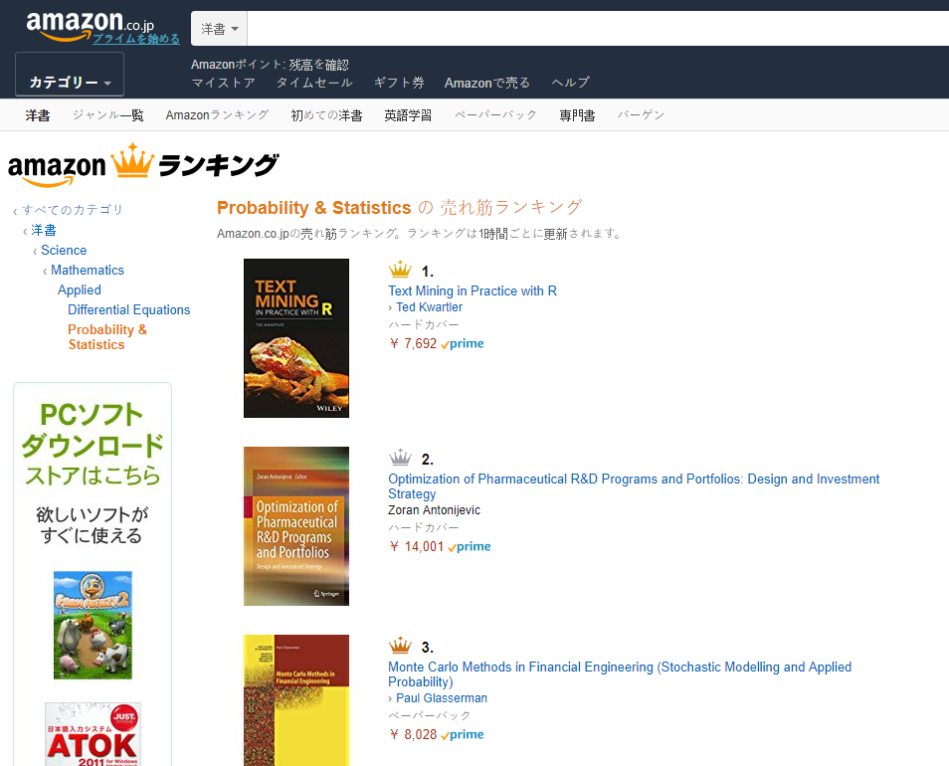

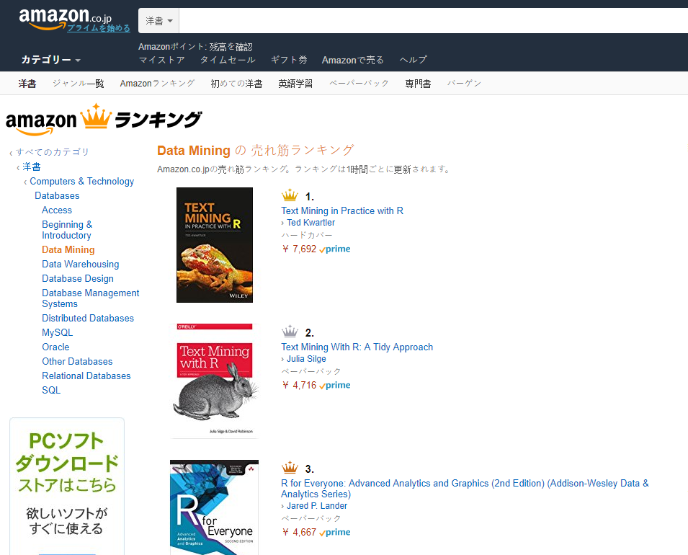

Shameless Plug #1

Slide 3


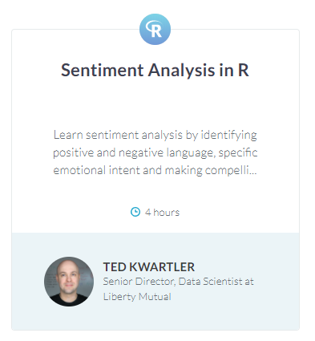
Shameless Plug #2

Slide 4
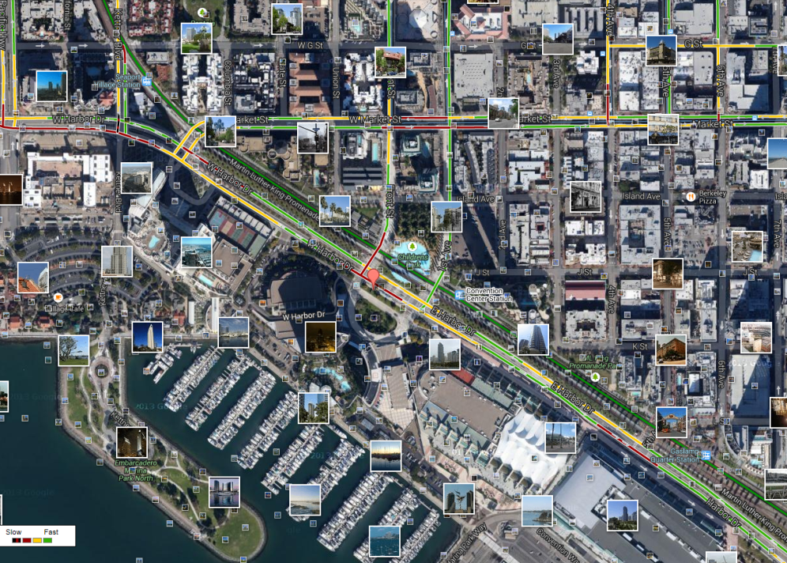
What is Text Mining?
Before Text Mining
Extract new insights from text
Let’s you drink from a fire hose of information
Language is hard; many unsolved problems
Unstructured
Expression is individualistic
Multi-language/cultural implications

Slide 5
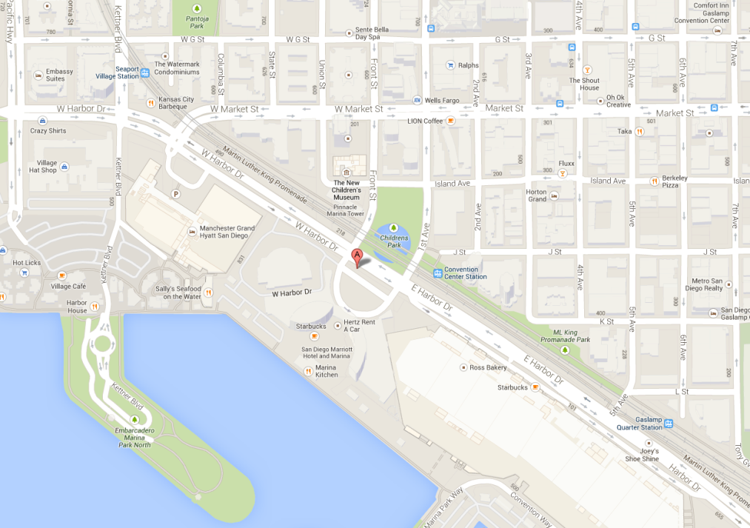
What is Text Mining?
After Text Mining
Extract new insights from text
Let’s you drink from a fire hose of information
Language is hard; many unsolved problems
Unstructured
Expression is individualistic
Multi-language/cultural implications

Slide 6
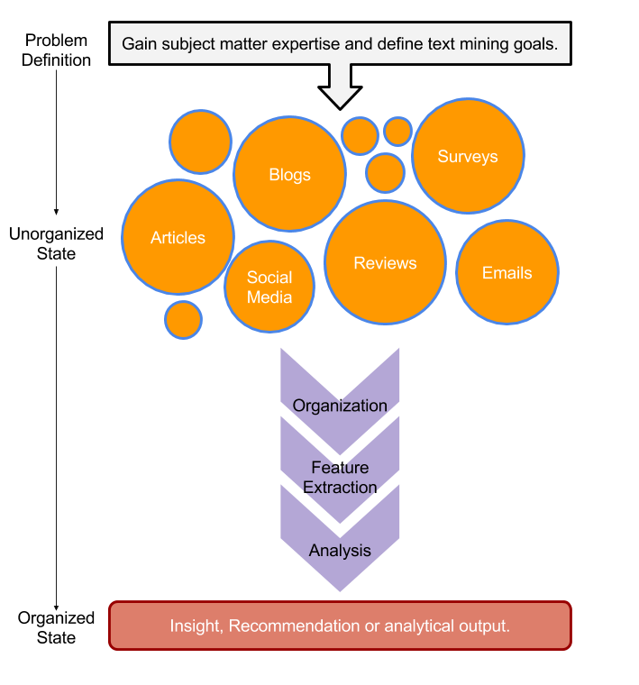
TM Project Workflow
Unorganized State
Natural Language Processing & Analysis
Organized State

Slide 7
Text Mining Workflow
Problem Definition
Identify Text Sources
Text Organization
Feature Extraction
Analytics
Reach Insight or Recommendation

Slide 8
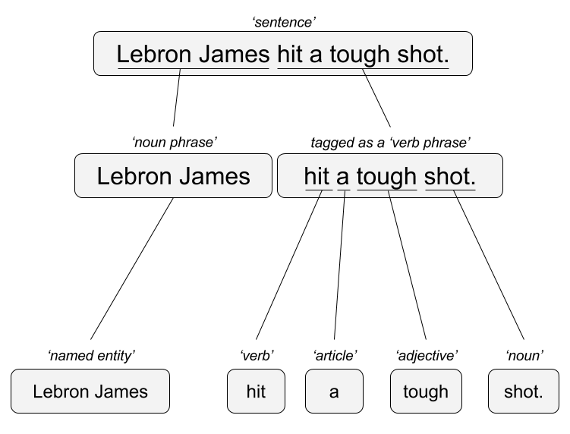

Two Popular Approaches – we will focus on BOW
“Lebron James hit a tough shot.”
Syntactic Parsing
Bag of Words
Lebron
a
James
hit
tough
shot

Slide 9
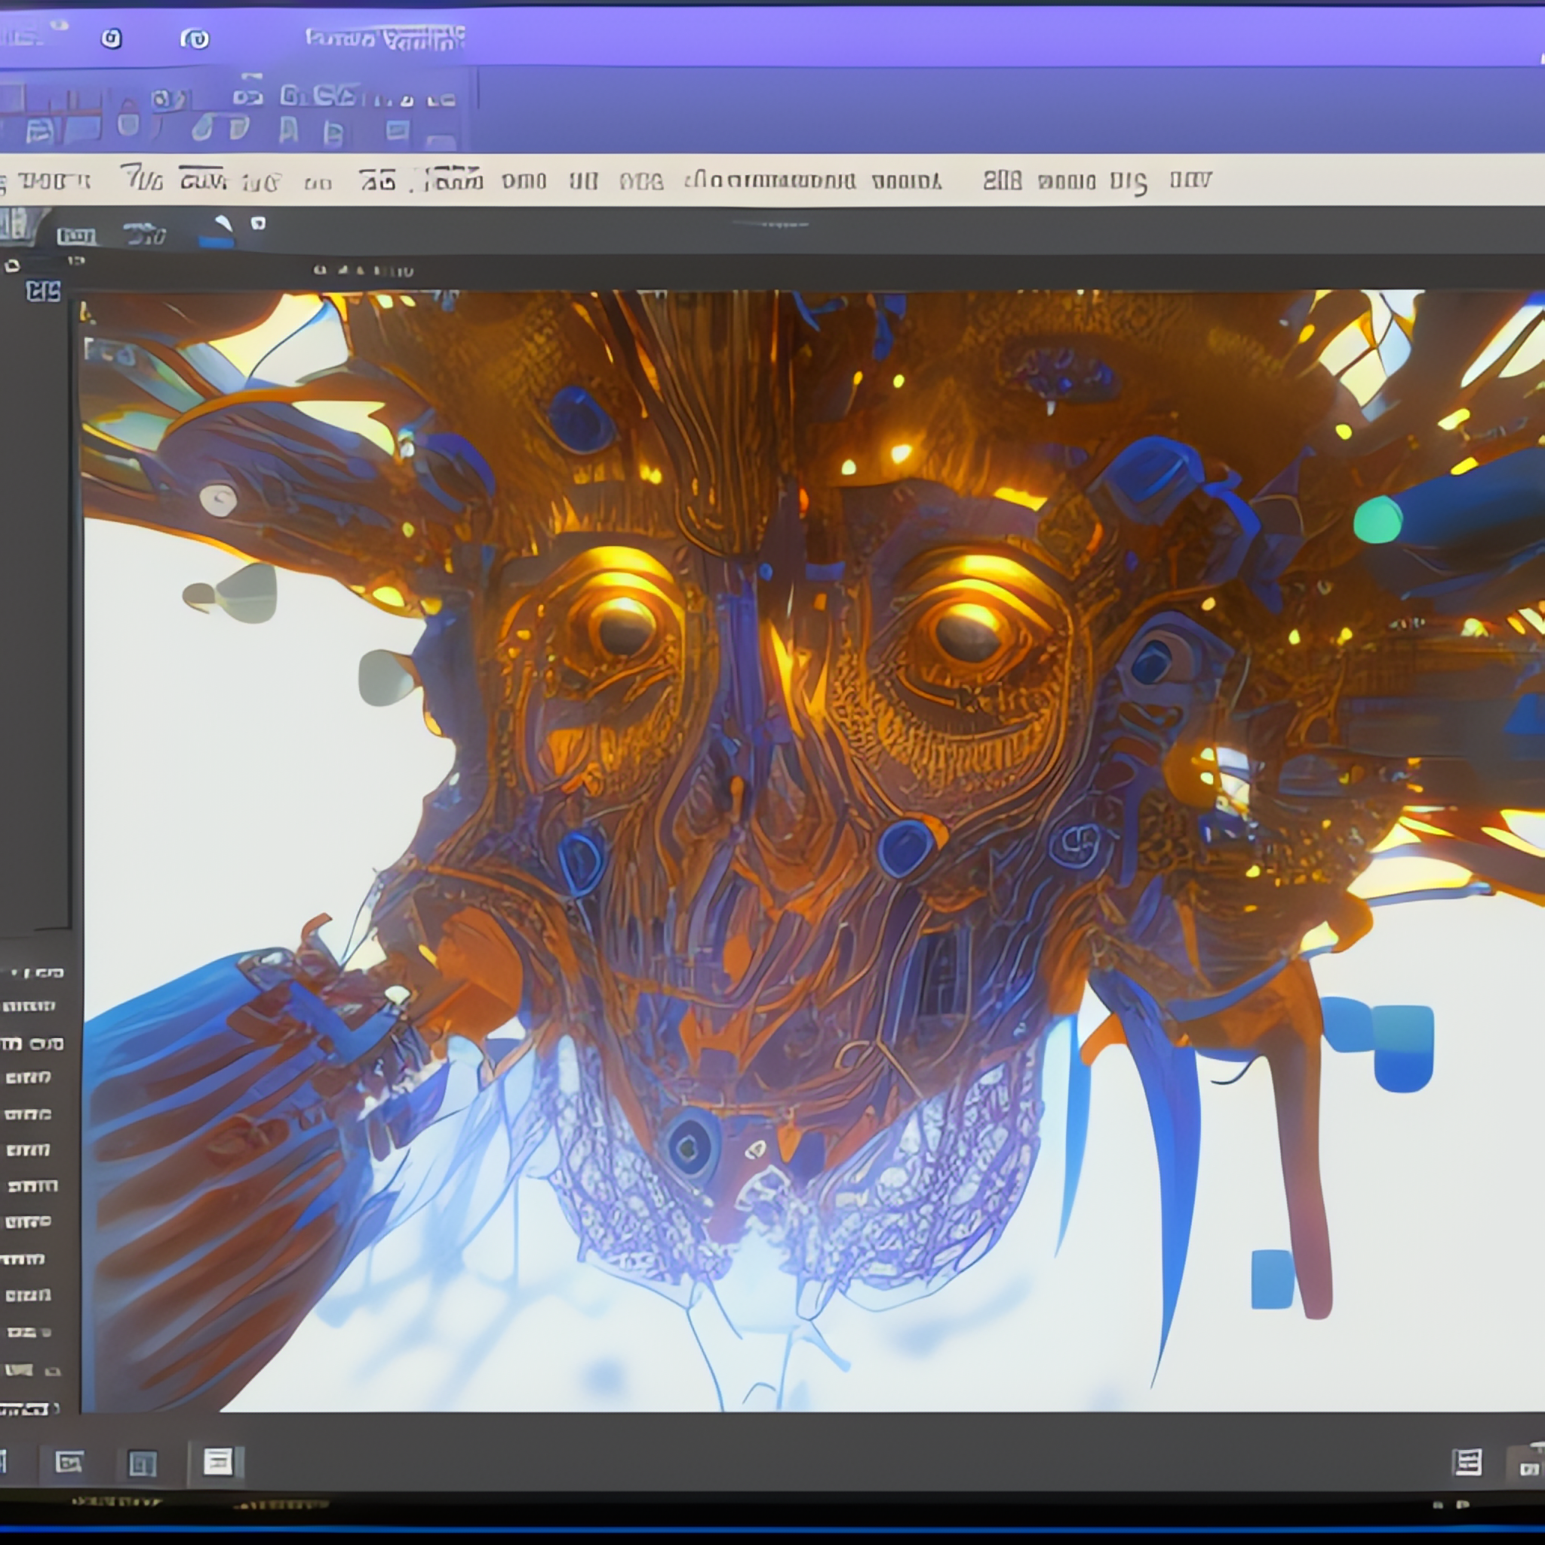
There is a third way…deep neural networks
Deep Neural Network
Vector Embeddings
LLM?
Large Corpus Input
0.5
0.5
Cat
[0.5, 0.5, 0.1]
0.6
0.1
0.2
Dog
[0.6, 0.2, 0.8]
0.8
Stable Diffusion w/mdjrny-v4 finetuning prompt:
deep neural network creating word outputs on a computer screen detailed intricate dynamic lighting

Slide 10
2 vector space
Cat
[0.5, 0.5, …]
.05
Cat
Dog
Claw
[0.6, 0.2, …]
.02
Dog
Human
.001
Human
[0.01, 0.001, …]
.01
.05
.06
4 leg animal
In this vector space which two are most similar?

Slide 11
GPT Glossary
LLM – Large language model
GPT - GPT stands for Generative Pre-trained Transformer
Word Embedding – library(text2vec) representations of words, phrases and documents as vectors of real numbers. It is a way of representing words and phrases as numerical values that can be used in machine learning algorithms. Word embeddings capture the context of words in a given corpus, allowing machines to understand the meaning of words in relation to each other.
RNN– library(keras) library(MXNet)?, library(rnn) Recurrent neural network processes sequential data. As data passes through the neural network previous inputs are “remembered” and inform the next prediction. This differs from “feed forward” networks.
Language Transformers– library(transformer) convert natural language into another form of language. It can be used to translate text from one language to another, or to convert text into a different format such as HTML or a description into a coding language.
Because of the size of the data, and speed, you wouldn’t build a GPT in R.

Slide 12
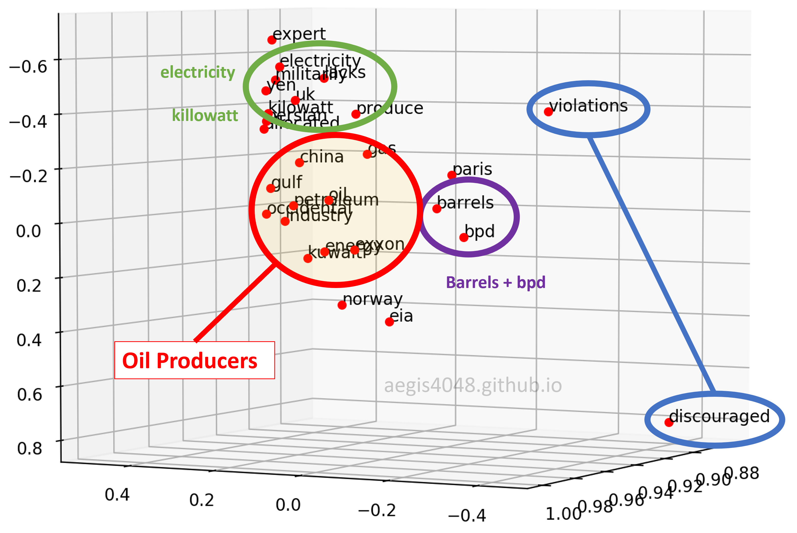
Vector/Pattern/DNN – Generative [GPT]
“Lebron James hit a tough shot.”
Vectors exist for the terms – vector for Lebron James, has commonalities with basketball, celebrity, & male in many dimensions simultaneously.

Slide 13
Generative [GPT]
The model uses the word embeddings, recurrent neural networks and language transformers to recognize words and phrase concepts that are then used for text generation.
User: Tell me about the oil industry.
Word Embedding: inquiry, personalization, oil, industry, business…
Response Construction:
+”sure”, [pattern to respond to inquiry]
+Add vector “sure” and generate next phrase: “here are some industry topics for you” [pattern to respond to inquiry, sure & personalization]
+Add vector “industry topics” and generate next phrase “The Gulf states…” from “oil industry”
+Add “Gulf states” vector generate “produce petroleum” vector
+Add “produce petroleum” vector, generate next phrase “in barrels”.
Response to User: Sure Here are some industry topics. The Gulf states produce petroleum in barrels…

Slide 14

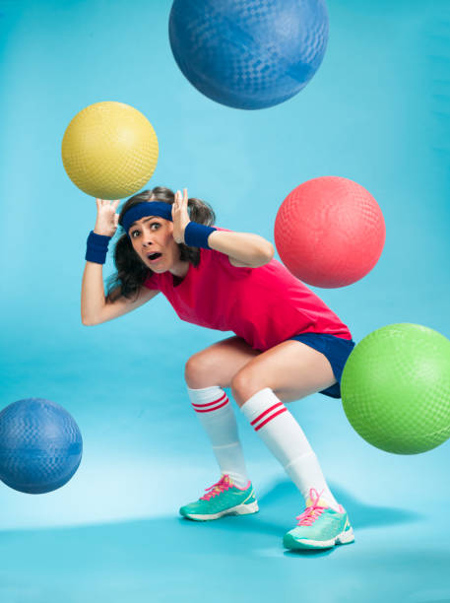
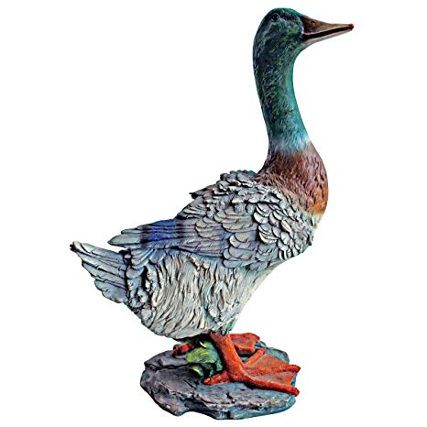
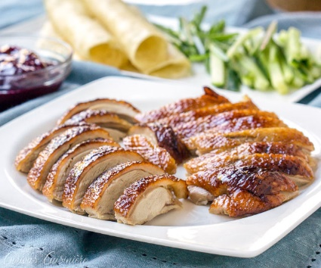
NLP/TM Challenges - Disambiguation
I made her duck.
I cooked waterfowl for her to eat.
I cooked waterfowl belonging to her.
I created the (clay?) duck and gave it to her.
Duck!!

Slide 15
NLP is hard!
Other Challenges
Examples
Compound words (tokenization) change meaning
Sarcasm
Cultural differences
“Bad” vs “not bad”
“I like it…NOT!”
“It’s wicked good” (in Boston)

Slide 16





Why text mining is an art & science?
Challenges because human expression is diverse, often ambiguous, affected by age, demographics, socio-economics, medium/channel & regional attributes of the author.
Common Sources
Source & context are important, directly impacting data integrity.
Books
Electronic Docs (PDFs)
Blogs
Websites
Social Media
Customer Records
Customer Service Notes
Notes
Emails
Legal Documents
…

Slide 17



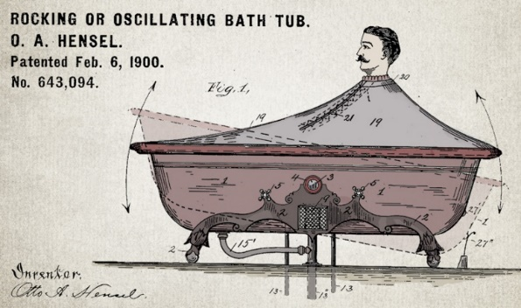

Channel affects language
🐝🔀🙏👁️👁️➡️🌎
Legal documents are verbose & technical.
“Be the change you want to see in the world.”
“kappa” indicates sarcasm, irony,
or a joke among online gamers.
Expression is context specific making analysis challenging.

Slide 18
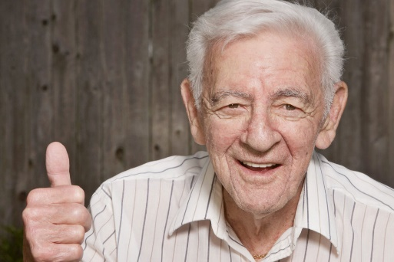

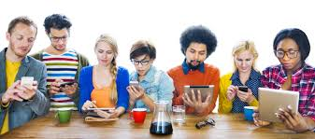
Messenger affects language
Boomers 1946-1964
* Make a difference * Consensus/team * Experiment/try new things * “Imagine if…” * Save time * Features and benefits
Gen X 1965-1980
Best, finest, world-class
“You will benefit by…”
”This is in your best interest.”
Gen Y 1981-2000
Global citizen
Balance
Diversity
Community/connections
Beyond generation, other factors like socio-economic, gender & demographic makeup impact expression.
https://www.anneloehr.com/

Slide 19


Hipster expression is evolving rapidly due to technology.
“Thank you, next.”
“Woke”
“Cray”
“Gucci”
“Squad goal”
“Bible…”
“Adulting”
“Turnt”
“Hundo P”
“Trill”
“TFW”
Beyond generation, other factors like socio-economic, gender & demographic makeup impact expression.

Slide 20
Gen Y/Z expression is evolving rapidly due to technology.
“Thank you, next.” – moving on with positive connotation
“Woke” - The more woke one is, the more sympathetic & knowledgeable one is about a topic or type of person
“Cray” - crazy
“Gucci” – fine, good
“Squad goal” – friend group behavior
“Bible…” - what follows is TRUTH
“Adulting” – activities associated with growing up
“Turnt” – “turned up” i.e. really excited
“Hundo P” – agree “100%”
“Trill” – True & Real
“TFW” – “That Feeling When” to describe an emotion
Beyond generation, other factors like socio-economic, gender & demographic makeup impact expression.

Slide 21

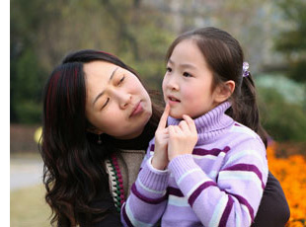
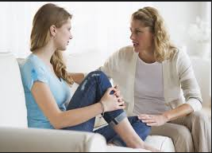

Audience affects language
And we all context switch based on who were are speaking too.

Slide 22

A safe/supportive learning environment
This text has never been read. “Keyboard Courage” is rampant which may entail some less than ideal topics.
Twitter is a realistic Natural Language Channel
It is a great place to get topics, and messy challenging data.
As a safe learning environment, no offense is intended, merely exposure to a real data set. If offended, please reach out and I will get you additional data sets.
#%@*!!!

Slide 23
A_Keyword_Scanning_revised.R
Basic R Unix Commands
Setup
grepl returns a vector of T/F if the pattern is present at least once
grepl(“pattern”, searchable object, ignore.case=TRUE)
grep returns the position of the pattern in the document
grep(“pattern”, searchable object, ignore.case=TRUE)
“library(stringi)” Functions
stri_count counts the number of patterns in a document
stri_count(searchable object, fixed=“pattern”)

Slide 24
Let’s Practice!
Open A_Keyword_Scanning_revised.R

Slide 25
Remember This?

Slide 26

R for Cleaning Steps
RT @WatcherGuru: JUST IN: Silicon Valley Bank $SIVB reportedly deactivated its Twitter account. https://t.co/vTkk1QK3zk
Remove Punctuation
Remove extra white space
Remove Numbers
Make Lower Case
Remove “stop” words
blogs
reviews
articles
rt watcherguru just silicon valley bank reportedly deactivated twitter account

Slide 27
Library TM Functions
VCorpus creates a corpus held in memory.
VCorpus(source)
tm_map applies the transformations for the cleaning
tm_map(corpus, function)
getTransformations() will list all standard tm corpus transformations. We can apply string functions from other packages with content_transformer(FUNCTION)
tm_map(corpus, removePunctuation) - removes punctuation from the documents
tm_map(corpus, stripWhitespace) - extra spaces, tabs are removed
tm_map(corpus, removeNumbers) - removes numbers
tm_map(corpus, content_transformer(tolower)) – makes all case lower
tm_map(corpus, removeWords) - removes specific “stopwords”
New Text Mining Concepts
Corpus- A collection of documents that analysis will be based on.
Stopwords – are common words that provide very little insight, often articles like “a”, “the”. Customizing them is sometimes key in order to extract valuable insights.
4/10/23
Kwartler
27

Slide 28
Custom Functions in 2_Cleaning_and_Frequency_Count.R
“tryTolower” is poached to account for errors when making lowercase.
tryTolower <- function(x){
# return NA when there is an error
y = NA
# tryCatch error
try_error = tryCatch(tolower(x), error = function(e) e)
# if not an error
if (!inherits(try_error, 'error'))
y = tolower(x)
return(y)}
“clean.corpus” makes applying all transformations easier.
cleanCorpus<-function(corpus, customStopwords){
corpus <- tm_map(corpus, content_transformer(qdapRegex::rm_url))
corpus <- tm_map(corpus, removePunctuation)
corpus <- tm_map(corpus, stripWhitespace)
corpus <- tm_map(corpus, removeNumbers)
corpus <- tm_map(corpus, content_transformer(tryTolower))
corpus <- tm_map(corpus, removeWords, customStopwords)
return(corpus)
}

Slide 29
Nuances & Inputs for Setting Up a TM Project
“custom.stopwords” combines vectors of words to remove from the corpus
#Create custom stop words
customStopwords <- c(stopwords('english'), 'lol', 'smh')
Add channel specific stop words.
E.g. Twitter abbreviations
Retaining Meta Data Information
# Data
text <- read.csv('https://raw.githubusercontent.com/kwartler/Hult_Visualizing-Analyzing-Data-with-R/main/DD1/G_Mar14/data/coffeeVector.csv')
head(text$x)
# Make a volatile corpus
txtCorpus <- VCorpus(VectorSource(text$x))
# Preprocess the corpus
txtCorpus <- cleanCorpus(txtCorpus, customStopwords)

Slide 30
For Bag of Words, how is data organized?
Term Document Matrix
 | Tweet1 | Tweet2 | Tweet3 | Tweet4 | … | Tweet_n
Term1 | 1 | 0 | 3 | 0 | 0 | 0
Term2 | 1 | 1 | 0 | 0 | 0 | 0
Term3 | 1 | 0 | 0 | 2 | 0 | 0
… | 0 | 0 | 3 | 0 | 1 | 1
Term_n | 0 | 0 | 0 | 1 | 1 | 0
Code to Create the DTM/TDM and change to a matrix
Why are DTM & TDM Sparse? What do they represent?
txtTdm<-TermDocumentMatrix(txtCorpus)
txtTdmM<-as.matrix(txtTdm)
??
The matrices are sparse (many 0’s) so additional steps may be needed to extract information.

Slide 31
For Bag of Words, how is data organized?
Document Term Matrix
 | Term1 | Term2 | Term3 | … | Term_n
Tweet1 | 1 | 1 | 1 | 0 | 0
Tweet2 | 0 | 1 | 0 | 0 | 0
Tweet3 | 3 | 0 | 0 | 3 | 0
… | 0 | 0 | 0 | 1 | 1
Tweet_n | 0 | 0 | 0 | 1 | 0
Code to Create the DTM/TDM and change to a matrix
Why are DTM & TDM Sparse? What do they represent?
txtDtm<-DocumentTermMatrix(txtCorpus)
txtDtmM<-as.matrix(txtDtm)
??
The matrices are sparse (many 0’s) so additional steps may be needed to extract information.

Slide 32
Open B_Cleaning_and_Frequency_Count.R
DO NOT MAKE DTM and TDM in normal circumstances. This is just an example!!

Slide 33
Once cleaned, let’s get word frequencies.
beerFreq<-rowSums(beerTDMm)
beerFreq<-data.frame(word=names(beerFreq),frequency=beerFreq)
Term Document Matrix
Word Frequency Matrix
 | Tweet1 | Tweet2 | Tweet3 | Tweet4 | … | Tweet_n
Term1 | 0 | 0 | 0 | 0 | 0 | 0
Term2 | 1 | 1 | 0 | 0 | 0 | 0
Term3 | 1 | 0 | 0 | 2 | 0 | 0
… | 0 | 0 | 3 | 0 | 1 | 1
Term_n | 0 | 0 | 0 | 1 | 1 | 0
word | freq
Term1 | 0
Term2 | 2
Term3 | 3
… | 5
Term_n | 2

Slide 34
What about a DTM?
beerFreq<-???????(beerDTMm)
beerFreq<-data.frame(word=names(beerFreq),frequency=beerFreq)
Document Term Matrix
Word Frequency Matrix
 | Term1 | Term2 | Term3 | … | Term_n
Tweet1 | 0 | 1 | 1 | 0 | 0
Tweet2 | 0 | 1 | 0 | 0 | 0
Tweet3 | 0 | 0 | 0 | 3 | 0
… | 0 | 0 | 0 | 1 | 1
Tweet_n | 0 | 0 | 0 | 1 | 0
word | freq
Term1 | 0
Term2 | 2
Term3 | 3
… | 5
Term_n | 2
Can anyone think of how you could get a DTM to be a WFM?

Slide 35
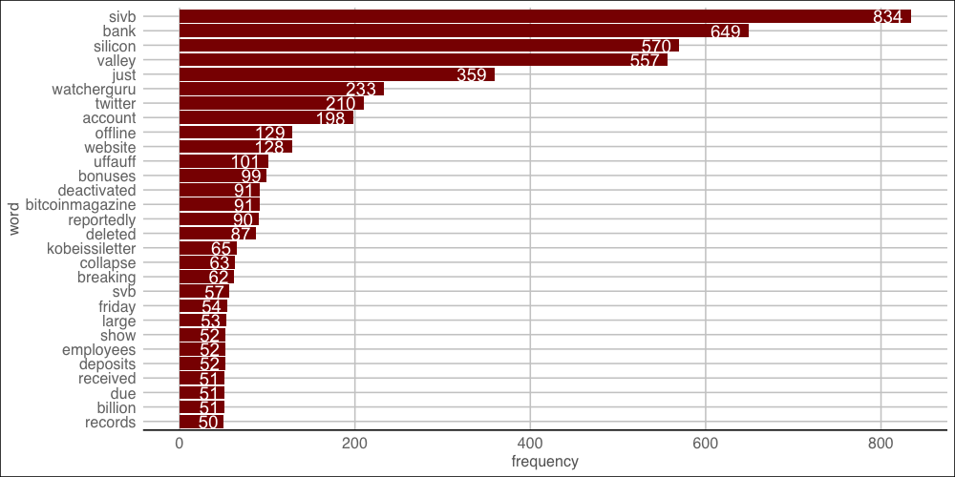
Open C_Frequency.R to visualize the WFM

Slide 36
Let’s look at a term specifically

Slide 37
What’s offline!! Word Association
# Inspect word associations
associations <- findAssocs(tweetDTM, 'offline', 0.10)
# Organize the results
tweetDF <- data.frame(terms = names(associations[[1]]),
value = unlist(associations),
row.names = NULL)
tweetDF$terms <- factor(tweetDF$terms, levels=tweetDF$terms)
ggplot(tweetDF, aes(y=reorder(terms,value))) +
geom_point(aes(x=value), data=tweetDF, col='#c00c00') +
theme_gdocs() +
geom_text(aes(x=value,label=value), colour="red",hjust="inward", vjust ="inward" )
Word Association is similar to correlation. When word A appears, how often does word B? Unlike correlation, terms can only be positively associated. This is because there are so many terms that everything would be “negatively correlated (associated). It is the % of time a word shows up in a document with another word.

Slide 38
Back to C_Frequency.R

Slide 39
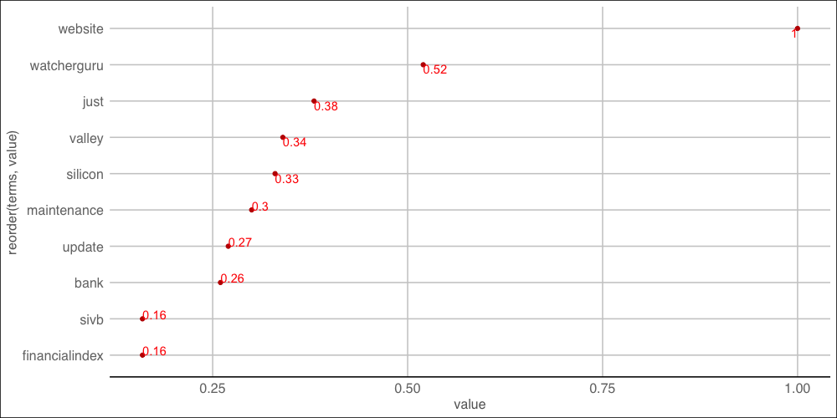
offline word Association
Website has the highest word association with “offline”
"RT @WatcherGuru: JUST IN: Silicon Valley Bank $SIVB website is offline. https://t.co/IG15KPWytE"

Slide 40
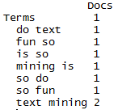
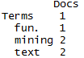
Tokenization
#bigram token maker
bigramTokens <-function(x)
unlist(lapply(NLP::ngrams(words(x), 2), paste, collapse = " "), use.names = FALSE)
tweetTDM <- DocumentTermMatrix(txtCorpus,
control=list(tokenize=bigramTokens))
Text Mining is so fun. So do Text Mining!
Unigram
Bigram
*with common stopwords
New Text Mining Concept
Tokenization- So far we have created single word n-grams. We can create multi word “tokens” like bigrams, or trigrams with this line function. It is applied when making the term document matrix.

Slide 41
What is a word cloud?
To make a word cloud we follow the previous steps and create a data frame with the word and the frequency.
# Get Row Sums
tweetTDMmVec <- sort(colSums(tweetTDMm), decreasing = TRUE)
wordFreqDF <- data.frame(word = names(tweetTDMmVec),
freq = tweetTDMmVec,
row.names = NULL)
Document Term Matrix
Word Frequency Matrix
 | Term1 | Term2 | Term3 | … | Term_n
Tweet1 | 0 | 1 | 1 | 0 | 0
Tweet2 | 0 | 1 | 0 | 0 | 0
Tweet3 | 0 | 0 | 0 | 3 | 0
… | 0 | 0 | 0 | 1 | 1
Tweet_n | 0 | 0 | 0 | 1 | 0
word | freq
Term1 | 0
Term2 | 2
Term3 | 3
… | 5
Term_n | 2
A word cloud is a visualization of term (token) frequencies.

Slide 42
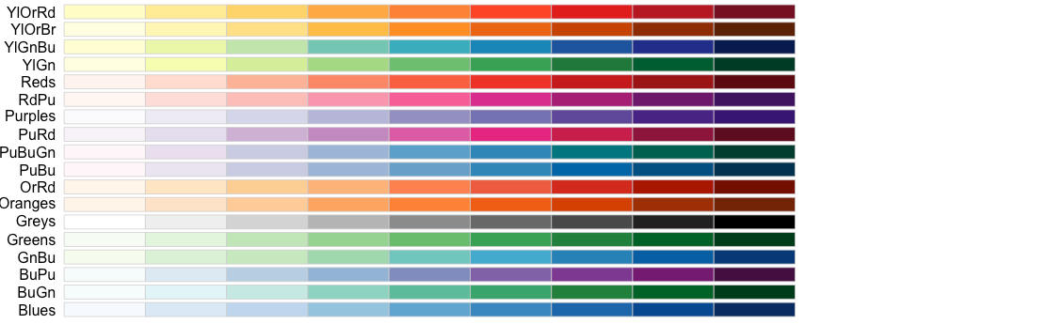
Selecting a color for your word cloud.
# Review all Pallettes
display.brewer.all()
# Choose a color & drop light ones
pal <- brewer.pal(8, "Blues")
pal <- pal[-(1:2)]

Slide 43
Let’s Practice!
D_Bigram_Wordcloud.R

Slide 44
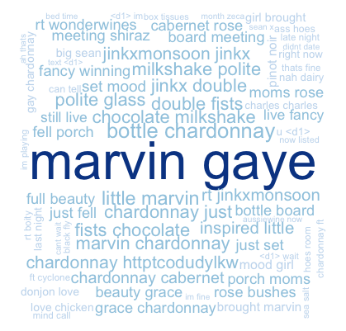
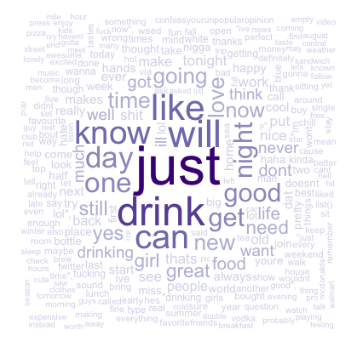
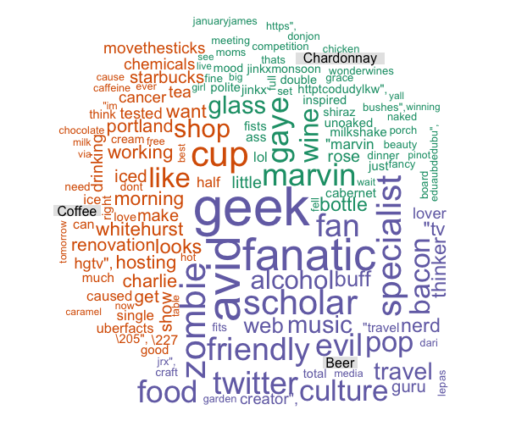
Types of Wordclouds
Multiple Corpora
Single Corpus
wordcloud( )
comparison.cloud( )
commonality.cloud( )
comparison.cloud( )
comparison.cloud( )

Slide 45
Dealing with many text files
The challenge is working with multiple corpora efficiently. Many ways to do it…
# Read in as a list
all <- lapply(txtFiles,read.csv)
# This could be made more concise but we're going to do it within a loop
cleanText <- list()
for(i in 1:length(all)){
x <- VCorpus(VectorSource(all[i])) #declare as a corpus
x <- cleanCorpus(x, customStopwords) #clean each corpus
x <- unlist(sapply(x, `[`, "content")) #extract out each cleaned text using content()
x <- paste(x, collapse = ' ') #collapse all text from 1000 tweet documents to 1 blob of text by subject
cleanText[[documentTopics[i]]] <- x #put it into the list
}

Slide 46
Lets make some improved word clouds
Open E_Other_Wordclouds.R

Slide 47
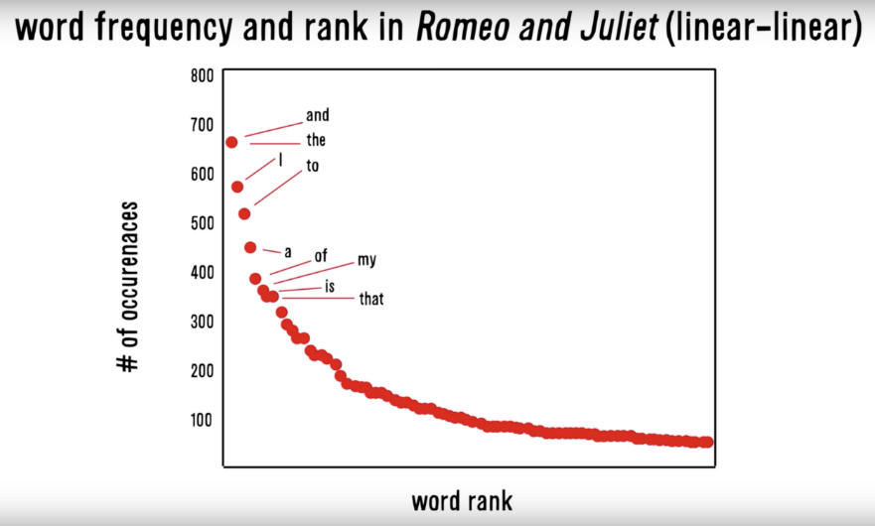
Zipf’s Law: Our words are less diverse than we think
Two very different contexts, channel, & messengers yet very similar pattern.
RT
I
Many words in natural language but also a steep decline in actual usage. Follows a predictable pattern.

Slide 48
Simple Sentiment Polarity
Scoring
Zipf’s Law
Surprise is a sentiment.
Hit by a bus! – Negative Polarity
Won the lottery!- Positive Polarity
Many words in natural language but there is steep decline in everyday usage. Follows a predictable pattern.
I loathe BestBuy Service -1
I love BestBuy Service. They are the best. +2
I like shopping at BestBuy but hate traffic. 0

Slide 49
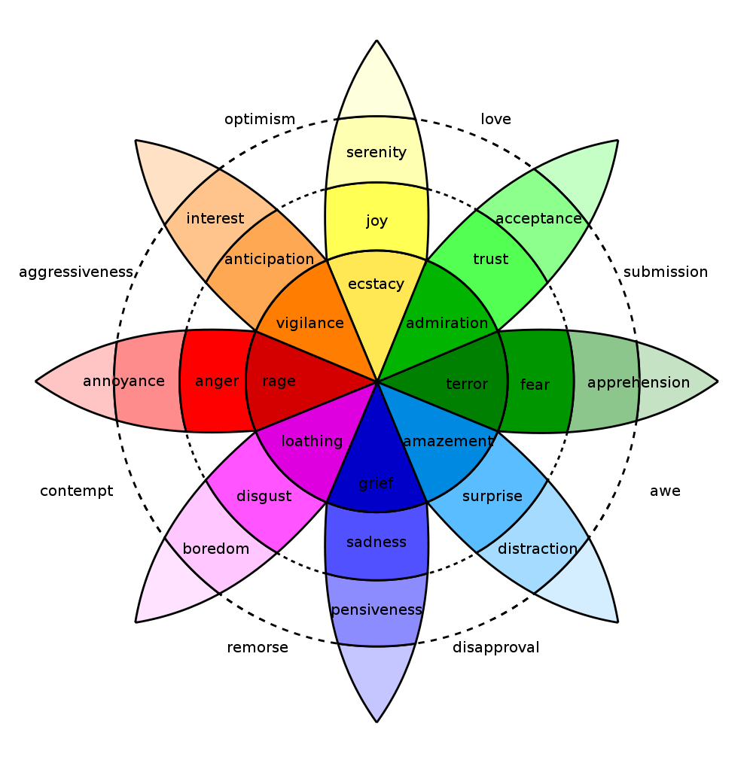
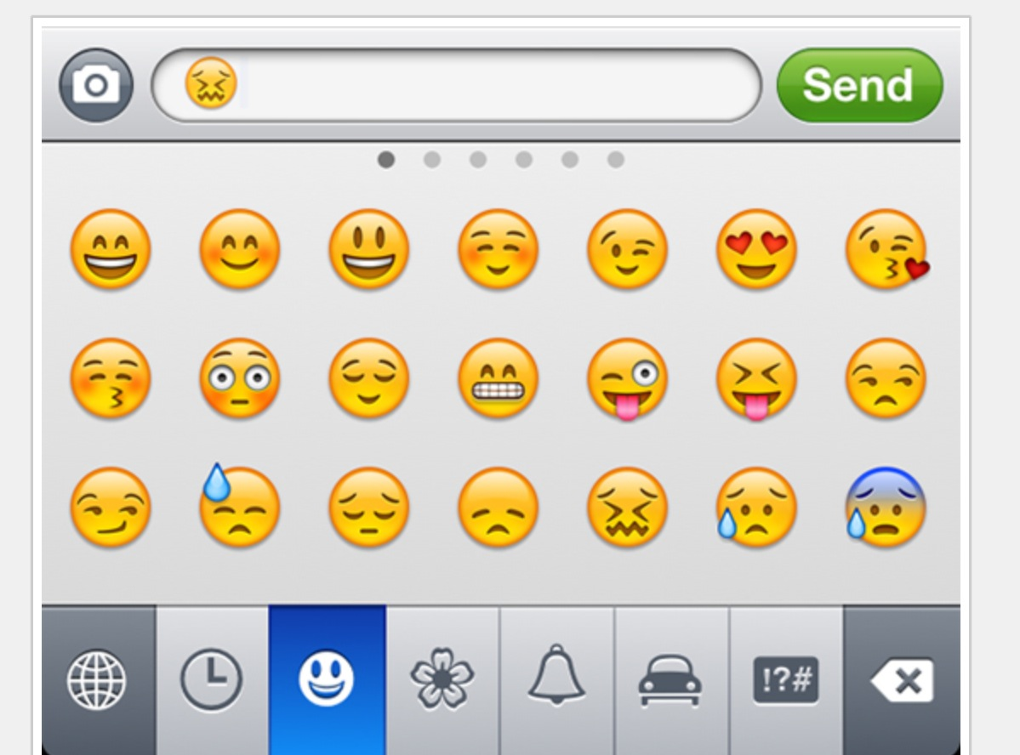
In reality sentiment is more complex.
Many Many Emoji
Plutchik’s Wheel

Slide 50
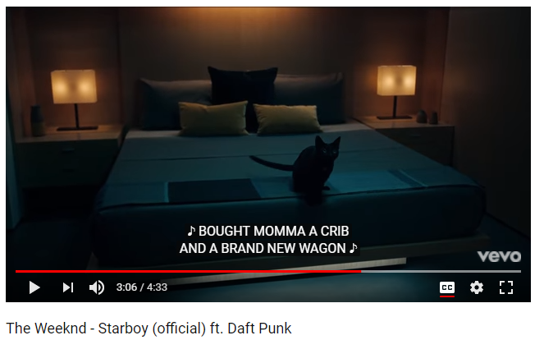
In this exercise we will examine song lyrics

Slide 51
But we will adjust the data format for joins
Tidy Form (Triplet, Dense Data)
Document Term Matrix
Document | Term | count
Tweet1 | Term2 | 1
Tweet1 | term3 | 1
Tweet2 | Term2 | 1
Tweet3 | Term… | 3
Tweet… | Term… | 1
Tweet… | Term_n | 1
Tweet_n | Term… | 1
 | Term1 | Term2 | Term3 | … | Term_n
Tweet1 | 0 | 1 | 1 | 0 | 0
Tweet2 | 0 | 1 | 0 | 0 | 0
Tweet3 | 0 | 0 | 0 | 3 | 0
… | 0 | 0 | 0 | 1 | 1
Tweet_n | 0 | 0 | 0 | 1 | 0
Sparse Data: Memory used to hold 0s
Dense Data: Efficient in Memory

Slide 52

And tidy programming uses the pipe operator…%>%

Slide 53
%>% just forward objects so don’t be intimidated
Tidytext is part of the tidy universe including ggplot and dplyr. Code is structured so it is more easily read using the %>%. The data format is a tibble and is in “tidy” format (long form).
mtcars %>% group_by(cyl) %>% mutate(rank = min_rank(desc(mpg)))
This reads as “Using the mtcars object then group by the cyl vector then mutate a new variable called rank.

Slide 54
Tidy can seem complicated but not impossible.
The pipe operator
%>%
Forwards an object so the code is easy to understand & concise.
all.sentiment <- all.tidy %>%
inner_join(nrc.lexicon) %>%
count(tweet,sentiment) %>%
spread(tweet, n, fill = 0)
Sentiment
words
Song text
inner_join()

Slide 55
Starting with a DTM, its straightforward
cleanTibbles <- list()
for(i in 1:length(all)){
x <- VCorpus(VectorSource(all[i])) #declare as a corpus
x <- cleanCorpus(x, customStopwords) #clean each corpus
x <- DocumentTermMatrix(x) #make a DTM
x <- tidy(x) #change orientation
x$document <- documentTopics[i]
cleanTibbles[[documentTopics[i]]] <- x #put it into the list
}
# Get bing lexicon
# "afinn", "bing", "nrc", "loughran"
bing<-get_sentiments(lexicon = c("bing"))
# Perform the join
bingSent <- inner_join(allText,
bing,
by=c('term'='word'))
DTM is from the “tm” library
Easy way to make it into a tibble.
Weeknd Lyrics
Bing Lexicon

Slide 56
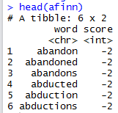
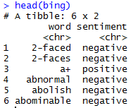
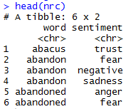
TidyText has other sentiment lexicons
Each can be used in an inner join to get different ways of assessing sentiment.
AFINN- Dutch researcher
Words scored -5 to 5
Bing- U of I-Chi Researcher
Words scored Pos/Neg
NRC – mTurk
Words classified into 8 primary & pos/neg
Weeknd Lyrics
Sentiment Lexicon

Slide 57
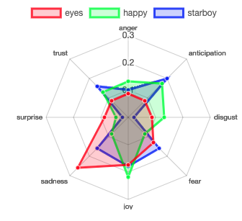
Remember Plutchik’s Wheel of emotion? Let’s mimic it!
The script drops positive & negative to focus on the explicit emotions.

Slide 58
Let’s practice sentiment analysis
Open 6_TidyText_Sentiment_revised.R
Open F_TidyText_Sentiment.R

